Slide 1
UNIT 1: DC CIRCUITS

Slide 2
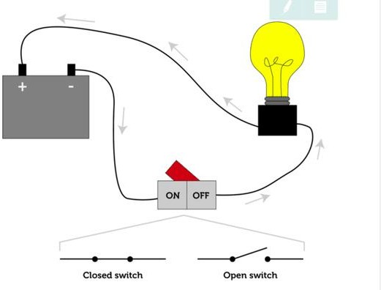
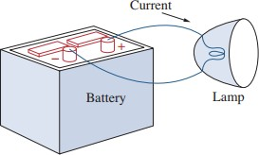
Electrical Circuit

Slide 3
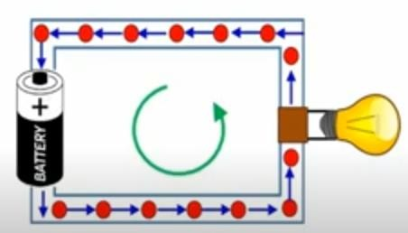
Charge and Current
Charge:
Charge is an electrical
property of the atomic particles of a matter.
S.I Unit: Coulomb (C)
Symbol: Q
Current: Rate of change of charge.
OR
Continuous flow electrons in an electrical circuit.
S.I Unit: Ampere (A) Symbol: I
of

Slide 4
Charge and Current
Mathematically,
𝑑𝑄
𝑡
𝑜𝑟 𝑄 = ∫ 𝐼. 𝑑𝑡
𝑡₀
𝐼 =
𝑑𝑡
Or, in simple terms:
𝑄
𝑇
𝐼 =
So, 1 Ampere = 1 coulomb/ 1 second.

Slide 5
QUICK QUIZ (Poll 1)
1 Coulomb is same as:
Watt /sec
Ampere/sec
Joule-sec
Ampere-sec

Slide 6
QUICK QUIZ (Poll 2)
The total charge entering the terminal is 5𝑠𝑖𝑛4𝜋𝑡 𝑚𝐶. Calculate current at t= 0.5 sec.:
A. 31.2 A
B. 31.2 mA
C. 62.8 mA
D. 62.8 A

Slide 7
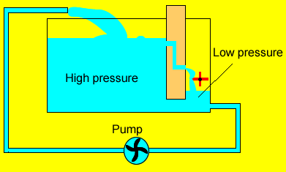
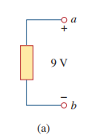
Voltage
It is the energy (Work) required to move a unit charge through an element.
S.I Unit: Volt (V) Symbol: V

Slide 8
Power and Energy
Power: Rate at which the work is done.
OR
Time rate of absorbing or supplying energy
S.I Unit: Watts (W) Symbol: P
Mathematically,
𝑃 = ^{𝑑𝑊}=^{𝑑𝑊} . ^{𝑑𝑞} = 𝑉.𝐼
𝑑𝑡 𝑑𝑞 𝑑𝑡
Implies,
𝑃 = 𝑉. 𝐼

Slide 9
Power and Energy
Energy: Capacity of doing work.
S.I Unit: Joules(J) Symbol: E

Slide 10
QUICK QUIZ (Poll 3)
Calculate the current ratings of 100 Watt incandescent bulb and 15 Watt LED lamp operated with the domestic supply of 220 Volt?
Bulb = 0.068 A and LED = 0.45 A
Bulb = 0.45 A and LED = 0.068 A
Bulb =0.50 A and LED = 0.068 A
Bulb = 0.50 and LED = 0.68 A

Slide 11
QUICK QUIZ (Poll 4)
From the previous question, it can be inferred that:
LED consumes 5 times more current than Bulb.
Bulb consumes 5 times more current than LED..
LED consumes 6.6 times more current than Bulb.
Bulb consumes 6.6 times more current than LED.

Slide 12
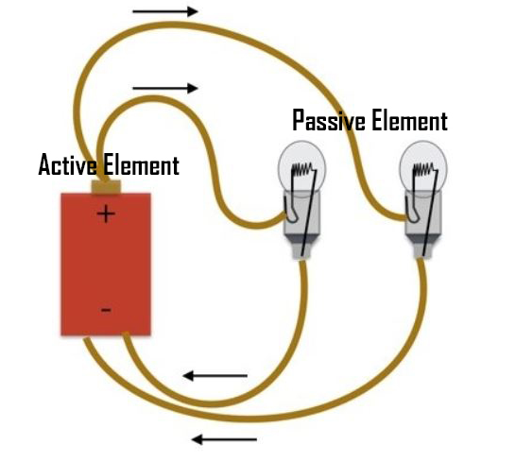
Network Components
Active
Passive
Battery
Resistance (R) Capacitance (C) Inductance (L)
Transformers
Transistor,
Op-amp,
Diode
VS and CS
Generators

Slide 13
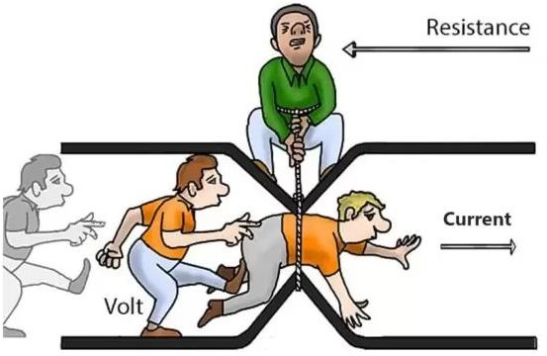

Resistance
Resistance: It is an opposition to the flow of current.
S.I Unit: Ohm (Ω)
Symbol: R

Slide 14

Capacitance
Capacitance is the ability of a device to store electrical energy in an electrostatic field.
A capacitor is a device that stores energy
in the form of an electrical field..
A capacitor is made of two conductors separated by a dielectric.
S.I Unit: Farad (F)
Symbol: C
Two important Properties:
No current flows through the capacitor, if the voltage remains constant.
Voltage across a capacitor cannot
change instantaneously.

Slide 15
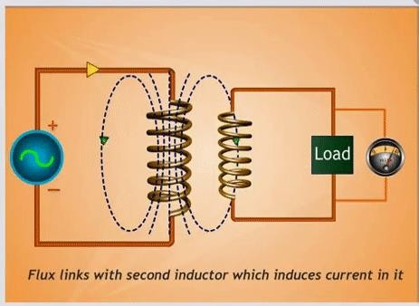
Inductance
Inductance is the characteristic of an electrical conductor that opposes a change in current flow.
An inductor is a device that stores energy in a
magnetic field.
When a current flows through a conductor,
magnetic field builds up around the conductor. This
field contains energy and is the foundation for inductance.
S.I Unit: Henry (H)
Symbol: L
Two important Properties:
No voltage appears across an inductor, if the current through it remains constant.
The current through an inductor cannot change
instantaneously.

Slide 16
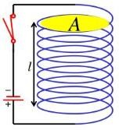
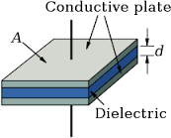
Capacitance and Inductance
𝑄 = 𝐶𝑉
𝑉 = 𝐿 ^{𝑑𝐼}
𝑑𝑄
𝑑 𝐶𝑉
𝑑𝑡
𝐼 =
=
= 𝐶
𝑑𝑉
1
2
𝑑𝑡
𝑑𝑡
𝐸 = 𝐿𝐼
𝑑𝑡
2
1
2
𝐸 = 𝐶𝑉
2
𝐿 =
𝜇𝑁 𝐴
2
𝗅(length of coil)
𝐶 = ^{𝐴∈}
𝑑

Slide 17
QUICK QUIZ (Poll 5)
Identify the passive element
Battery
Transformer
Transistor
OP-amp

Slide 18
QUICK QUIZ (Poll 6)
Find the value of capacitance if the value of voltage increases linearly from 0 to 100 V in 0.1 s causing a current flow of 5 mA?
10 µF
5 F
10 F
5 µF

Slide 19
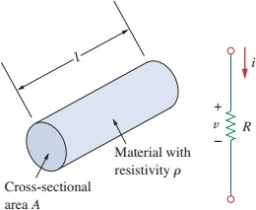
Ohm’s Law
Ohm’s law states that:
“the current in an electric circuit is directly proportional to the voltage across its terminals, provided that the physical parameters like
temperature, etc. remain constant”
Mathematically,
𝐼 α 𝑉
Or,
𝐼 = ^{𝑉}
𝑅
𝑙
Where, Resistance 𝑅 = ρ
𝐴

Slide 20
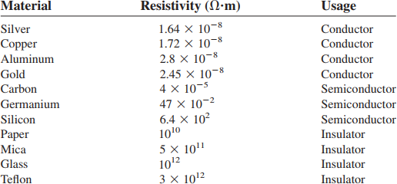
Resistivity Table

Slide 21
Conductance
A useful quantity in circuit analysis is the reciprocal of resistance R, known as conductance and denoted by G
𝐺 = ¹ = ^{𝐼}
𝑅 𝑉
S.I Unit: mho (ohm spelled backwards) or Siemens
Symbol:

Slide 22
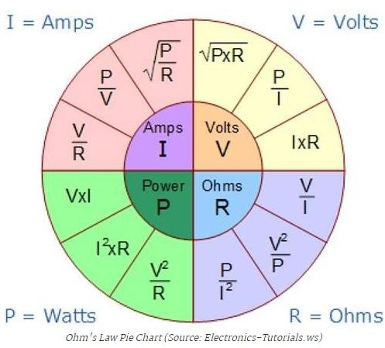
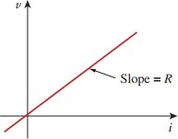
Power dissipated in the resistor can be expressed as:
2
𝑃 = 𝑉𝐼 = 𝐼²𝑅 = ^{𝑉}
𝑅

Slide 23
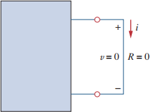
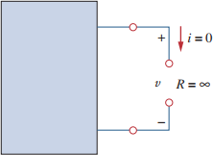
Short-circuit and Open-circuit
For a short circuit, R = 0 Ω
Therefore, V = I.R = 0 V
NOTE: (current, I can be of any value)
For an open circuit, R = ∞ Ω
Therefore, I = V/R = 0 V
NOTE: (voltage,V can be of any value)

Slide 24




Applications of Ohm’s Law
To find unknown Voltage (V)
To Find unknown Resistance (R)
To Find unknown Current (I)
Can be used to find Unknown Conductance (G)=1/R
Can be used to find unknown Power (P)=VI
Can be used to find unknown conductivity or Resistivity

Slide 25
Applications of Ohm’s Law
It is widely used in circuit analysis.
It is used in ammeter, multimeter, etc.
It is used to design resistors.
It is used to get the desired circuit drop in circuit design (Example, Domestic Fan Regulator).
Advanced laws such as Kirchhoff’s Norton’s law, Thevenin’s law are based on ohm’s law.
Electric heaters, kettles and other types of equipment working principle follow ohm’s law.
A laptop and mobile charger using DC power supply in operation and working principle of DC power supply depend on ohm’s law.

Slide 26
Limitations of Ohm’s Law
Ohm’s law holds true only for a conductor at a constant temperature. Resistivity changes with temperature.
Ohm’s law by itself is not sufficient to analyze circuits.
It is NOT applicable to non linear elements, For example, Diodes, Transistors, Thyristors, etc.
This law cannot be applied to unilateral networks.

Slide 27
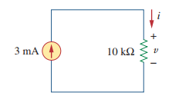
QUICK QUIZ (Poll 7)
The voltage and the conductance of the given circuit is:
30 V, 10 µS
30 mV, 100 µS
C. 30 V, 100 µS
D. 30 mV, 10 µS

Slide 28
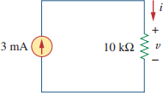
QUICK QUIZ (Poll 8)
The power of the given circuit is:
60 mW
70 mW
80 mW
90 mW

Slide 29
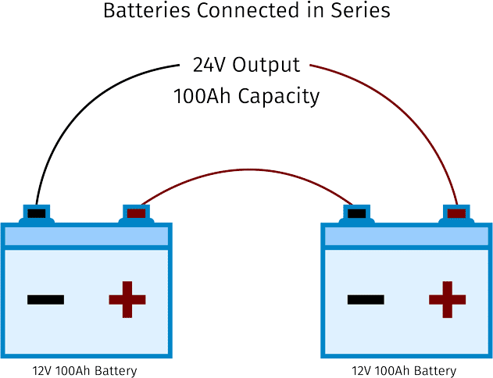
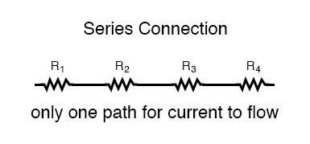
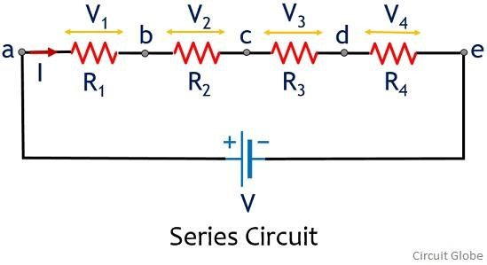
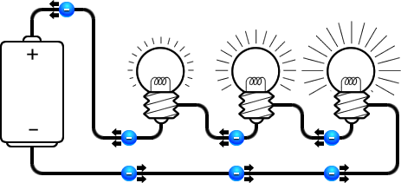
Series Connection
SERIES CONNECTION: Two or more elements are in series if they exclusively share a single node and consequently carry the same current.

Slide 30
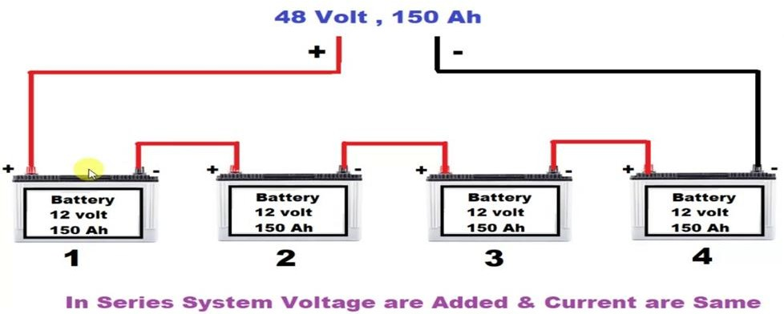
Point to Remember for Series Circuits

Slide 31
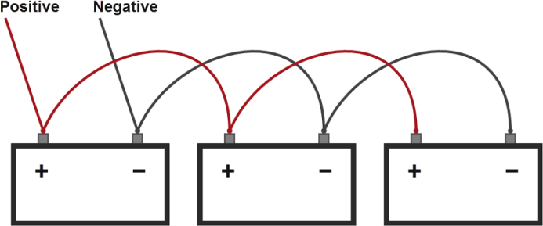
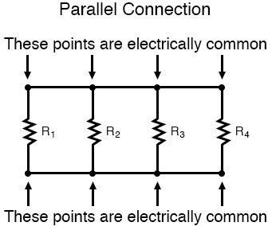
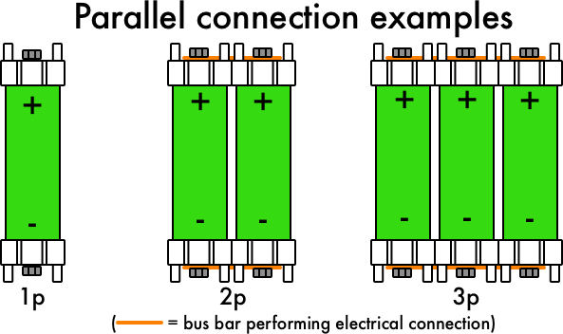
Parallel Connection
PARALLEL CONNECTION: Two or more elements are in parallel if they are connected to the same two nodes and consequently have the same voltage across them

Slide 32
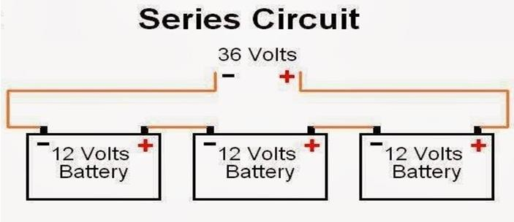
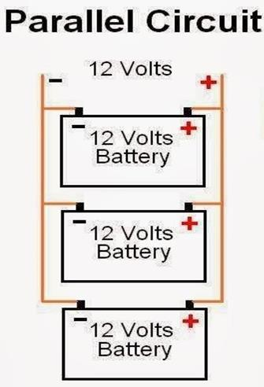
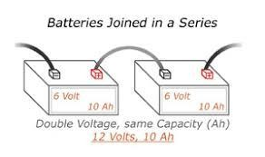
Battery Voltage In Series And Parallel

Slide 33
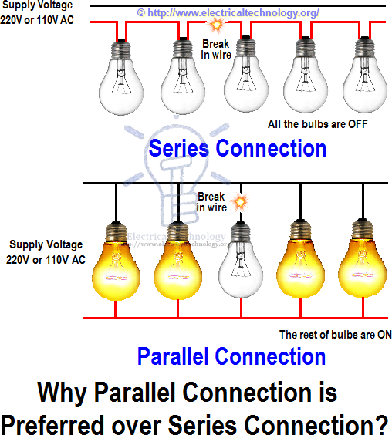

Slide 34
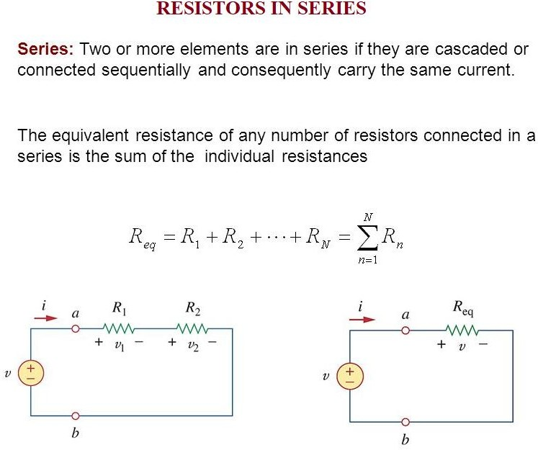
Note: Resistors in series behave as a single resistor whose resistance is equal to the sum of the resistances of the individual resistors.

Slide 35
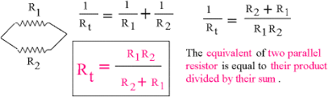
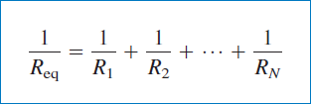
Resistors in Parallel
.

Slide 36
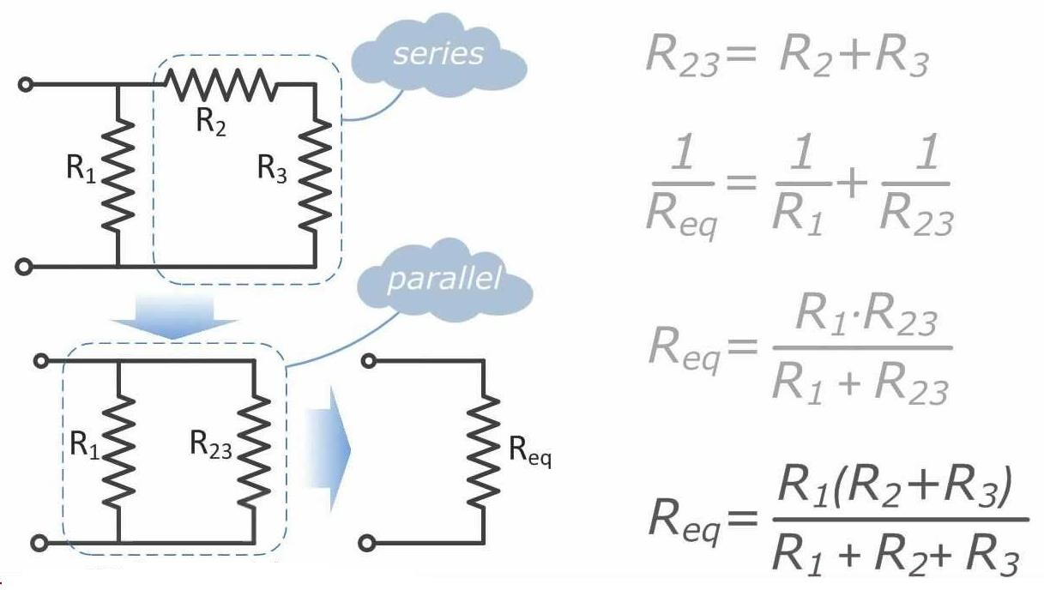
How to find Equivalent Resistance for Series-Parallel Combinations

Slide 37
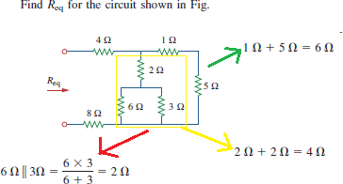
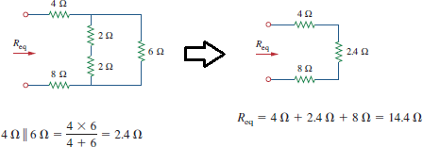
Example: To find 𝑹_{𝒆𝒒}

Slide 38
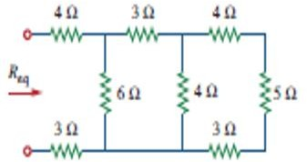
QUICK QUIZ (Poll 9)
Find Equivalent Resistance in Ohms?
5
10
15
20

Slide 39
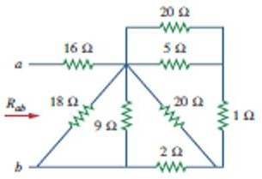
QUICK QUIZ (Poll 10)
Find Equivalent Resistance in Ohms?
12
17
19
29

